Slide 1
Stress Management
~ Anil, Himanshu

Slide 2
Agenda
What is stress?
Causes of stress
Impact of stress
How to handle the stress

Slide 3
What is stress?
Stress can be created and can be destroyed and also can be transfer from one person to another
~ Anil’s law of stress

Slide 4

is it a STATE of mind.…

Slide 5

is stress only there when I think about it OR is it ALWAYS there?

Slide 6
is it caused due to fear of failure?
And something else also
Uncertainty and doubt[FoF]
Deadline(fof)
Mental fatigue(fof)
Overthinking(fof)
Health(fof)
Envy & Comparison/ Weltschmerz(Empathy)

Slide 7
is stress additive OR multiplicative?
1+1 = 2
1*1 = 11

Slide 8

Is stress ALWAYS BAD?

Slide 9

stress is bad if too much, How much is too much?

Slide 10
How does stress impact your life?

Slide 11
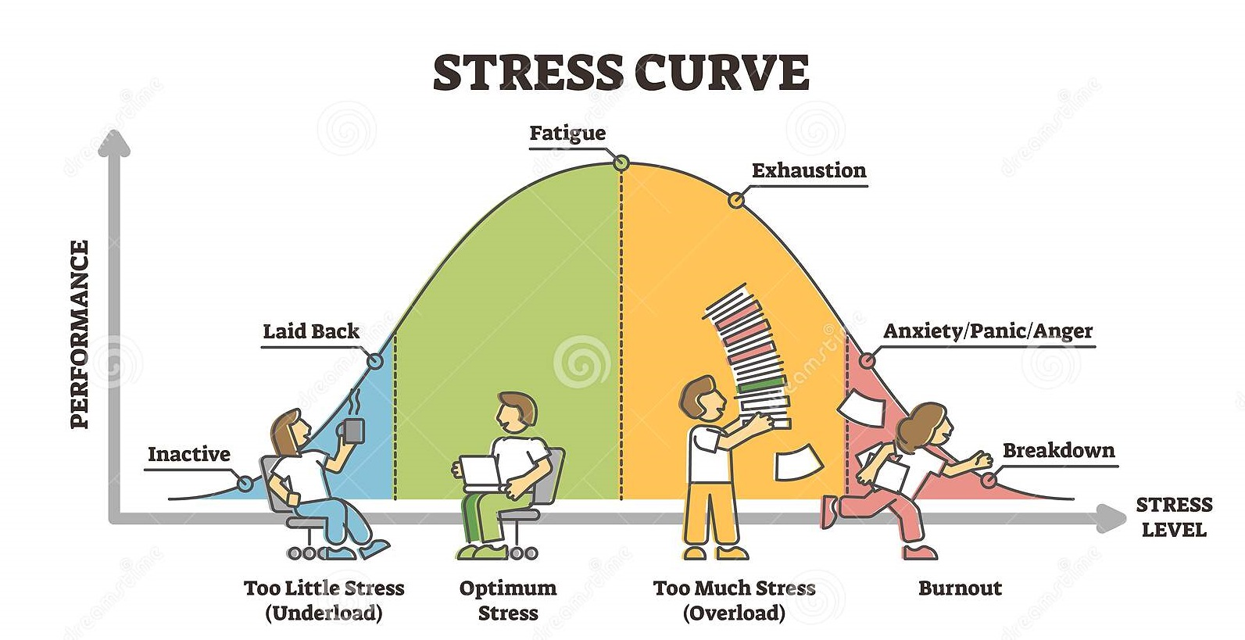

Slide 12
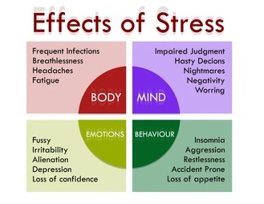

Slide 13

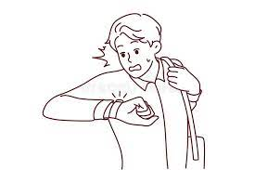
Stress cause can be divided into two categories
Things that already messed up 2. Things that can be messed if not handled

Slide 14
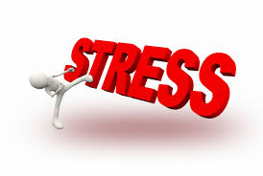
How to handle stress?
if anyone want to share his/her experience of stress handling

Slide 15

How to handle type 1 stress?
If You were not able to complete your work on the deadline which causing you stressed, what will you do?

Slide 16

Find your support system

Slide 17
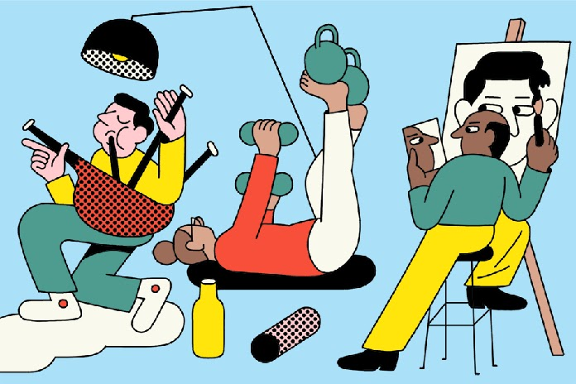
Socialize, Listen music, Exercise, find hobby

Slide 18
Other tips
Try some new routine
Reframe your thoughts
Change your attitude
Take proper Food & Diet
Meditation
Take proper sleep

Slide 19
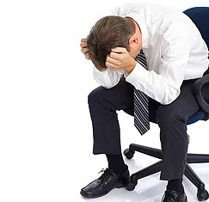
How to handle type 2 stress
Too much work to do and it is creating stress, what will you will you do?

Slide 20
Tips

Slide 21

How to handle type 2 stress
List down all the work
Break the big tasks into smaller
Decide the priority
And then forget all the tasks and start with highest priority
Take proper breaks
Take time for yourself
Seek help with problems
Be realistic

Slide 22
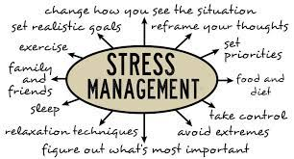
How to handle stress: Summary

Slide 23
Final tip
Maintain the balance in work and life as well as in your account

Slide 24


Slide 25
Questions?

